Slide 1
Simple social platform to connect with college peers (Connecture)
Guide :- Dr. Pravin Adivarekar
Devansh Katheria Aditya Yadav
Shauryan Singh Riddhi Narkar
Notes:
A very good afternoon everyone, this is Riddhi and here today I’ll be talking about our mini project which is a simple social platform to connect with college peers. Along with me, working on this project are Devansh, Aditya, and Shuaryan under the guidance of Dr. Pravin Adivarekar.

Slide 2
Problem Statement
• Exploring new technology, knowledge, and skills is an important step to try to find a new passion or to polish an existing one. But, finding and connecting with new people who share a common interest can be a bit overwhelming at times.
• We would be addressing this very issue by designing a centralized platform wherein students and teachers can build new connections, post information and stuff that can help to create an inspiring and encouraging environment to learn, develop and venture for all.
• For this mini-project, we aim to develop an online social media platform at an institute level wherein students can connect with and share tech-related ideas, knowledge and help foster a rich coding culture in our college.
Notes:
Let me walk you through the problem statement. College is really a fun place where everyone tries to grow and develop, learn new skills, meet new people, find hobbies and passion. But, it is really common and easy to get a but lost here. Majorly this situation arises due to confusion or just the fact that you don’t know enough people, or have a really a good guidance or some sort of backup. So, while addressing this issue, we thought of creating a unified digital platform which would help to overcome many of such problems. One can build connections, know more people very easily than what he/she can in real life and hence, spiking his/her development curve. That’s exactly what we aspire to develop for this mini-project, an online social tool at an institute level, where all students can interact with each other, including the faculties and share new ideas and concepts, just about anything that gets people interested in tech, and hence help foster a rich tech culture in out college. Also, this would help everyone to keep themselves update with the current tech scenario and help others to do the same.

Slide 3
Abstract
This project is based on the concept of making new and meaningful connections.
By providing access to all college peers on a single platform, getting to know peers with a similar interest can help to guide and inspire students.
We already have many sophisticated social platforms to connect with people, but, a setup at an institute-level would significantly help to bind everyone by leveraging the ability to connect digitally.
Notes:
Let me again quickly explain you the abstract here. This platform is solely based on the concept on making meaningful and new connections. When it comes to succeeding, it is important to maintain a constant supportive environment, and being surrounded by people with similar interests, and that is what this platform will cater to. By providing access to every student on a single, organised digital platform would significantly change the way college students interact. We really have enough sophisticated social platforms which help to achieve the same - connections, but the real difference is that a setup right at the institute level leverages this digital service into helping student form strong communities.

Slide 4
Scope
This project is will be implemented in an institute level.
This way, all college students will have a dedicated and organized and centralized platform wherein they can find other students with similar interests.
The underlying idea behind this project is to increase the quality and quantity of interactions students have about technology in an institute.

Slide 5
Objectives
1) To develop a rich coding culture in college.
2) To help college students connect and interact in a way that would lead to their skill development.
3) To keep everyone updated about the current technical scenario and to present them with opportunities which would strengthen their vital skills in their college years.

Slide 6
Benefits
Will create a very supportive and collaborative environment for students to create communities.
Will help them to meet new people with similar interests so that they can work together to achieve a similar goal.
Can act as a medium to keep students updated with the current technical scenario.

Slide 7
Existing system/project
SMPs like Facebook really aims towards meeting new people and connecting with them to make a broader community.
LinkedIn is focused on making meaningful connections with people who could help them in professional needs. But both these systems are implemented on a global level and their reach is huge.
Bringing a well-planned mix of some of the features of these SMPs and changing the reach level makes this project different. We are leveraging the same – the concept of SMP to enhance connections, but on an institute level and in a way that benefits all.

Slide 8
Introduction

Slide 9
User Account
• Every user will have a unique account with unique details such as a username and a password.
• After creating a new account, users will have to set up their profile.
• A profile will consist of basic personal information like name, photo, year, areas of interest, a bio, and a few optional contact details.
• To encourage stronger and faster connection, all profiles would be completely open to everyone using this platform.

Slide 10
Posts, Feed and Notifications
• Posts could be pictures or just simple text. Text type posts could be a short paragraph or questions.
• Posts could be liked and commented.
• Any post made by anyone will be visible in everyone’s feed and anyone can interact with it.
• All posts will have tags regarding its content. Users will have to add them while making a new post.
• User will receive notifications when feed is updated or if there are interactions with their posts.

Slide 11
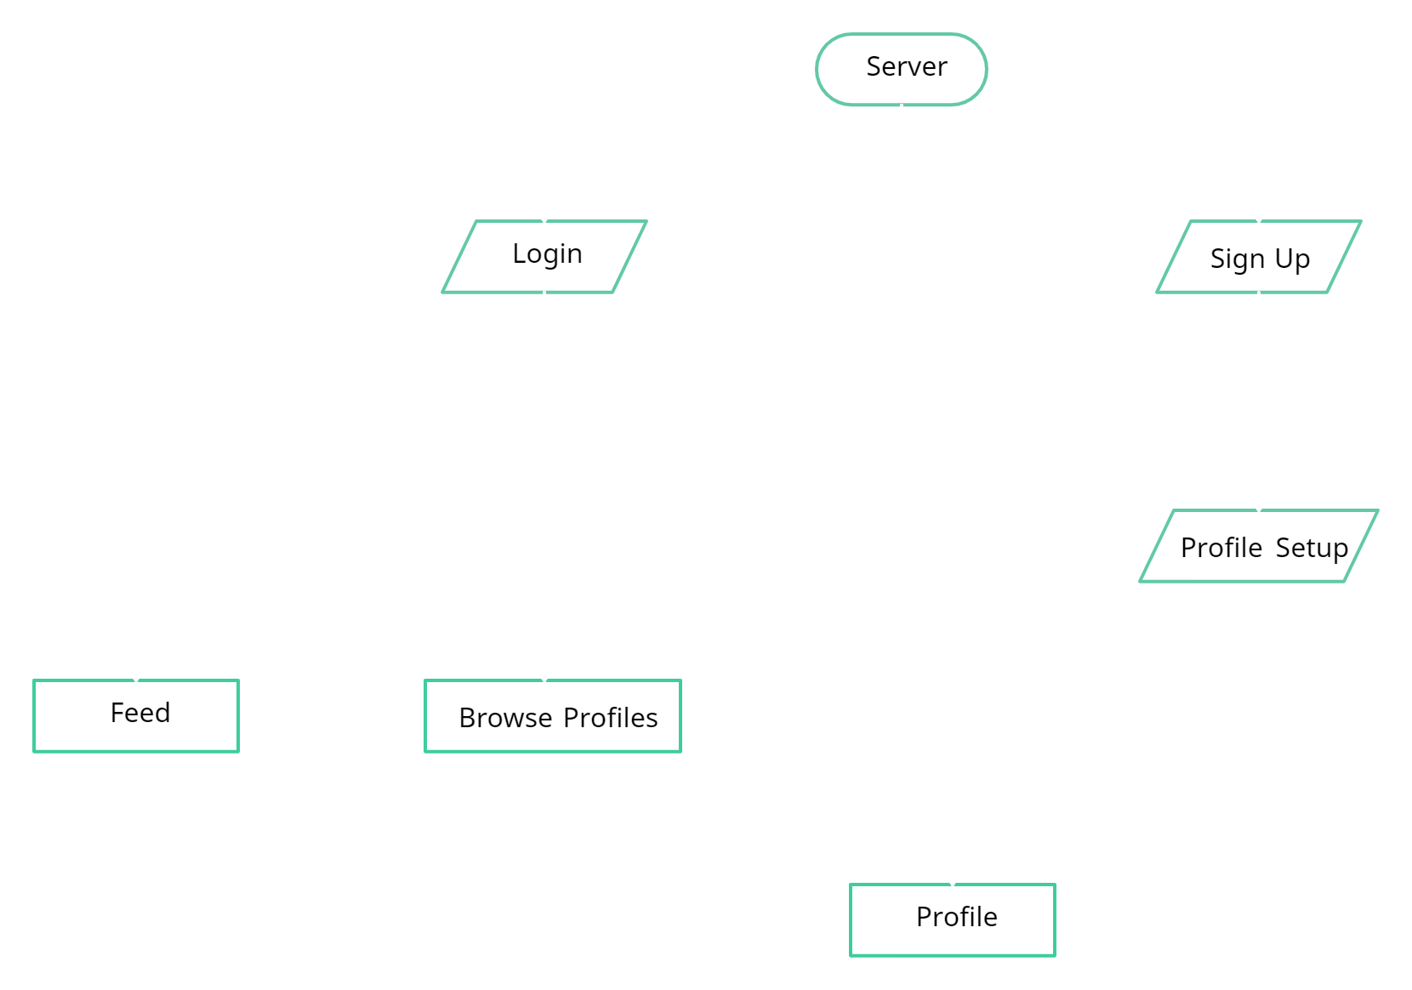
Flow Of Modules

Slide 12
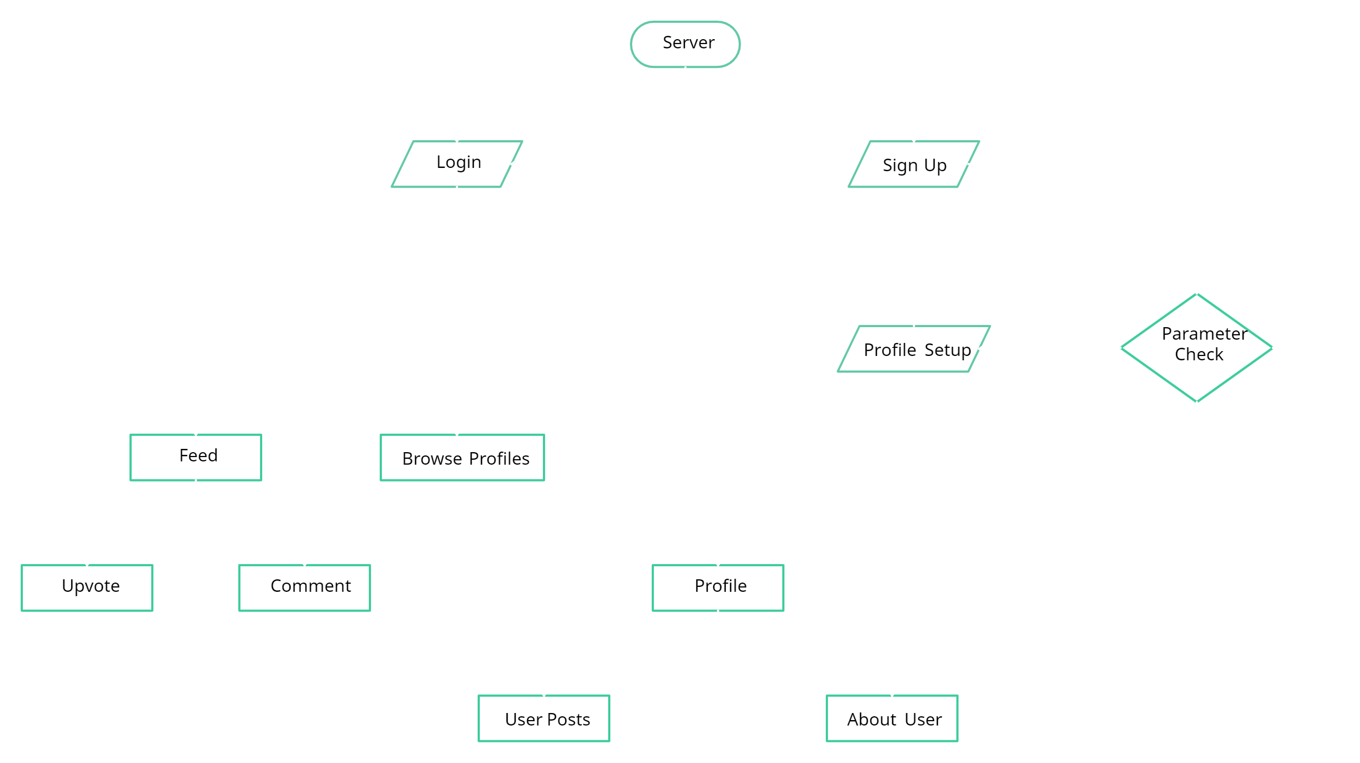
Data Flow

Slide 13
Technology Stack
HTML, CSS, Vanilla JS, and React JS - Frontend
MERN stack - Backend, database, server hosting

